Slide 1

Title Slide: Methods for Estimating Project Time and Cost
This presentation covers various methods for estimating project time and cost, essential for effective project management.
Accuracy in estimation leads to better project planning and execution.
Estimating is a critical skill for project managers.
The presentation aligns with Section 5.4 of Larson & Gray 8th Edition.

Slide 2

Purpose of Estimating
Estimating time and cost is crucial for successful project outcomes.
Project Planning: Forms the basis for project schedules and resource allocation.
Scheduling: Enables realistic timelines and milestone setting.
Budgeting: Provides a financial framework for project execution.
Decision-Making: Supports informed decisions on project feasibility and scope.
Feasibility Studies: Assesses project viability before initiation.
Performance Evaluation: Sets benchmarks for monitoring project progress and efficiency.

Slide 3
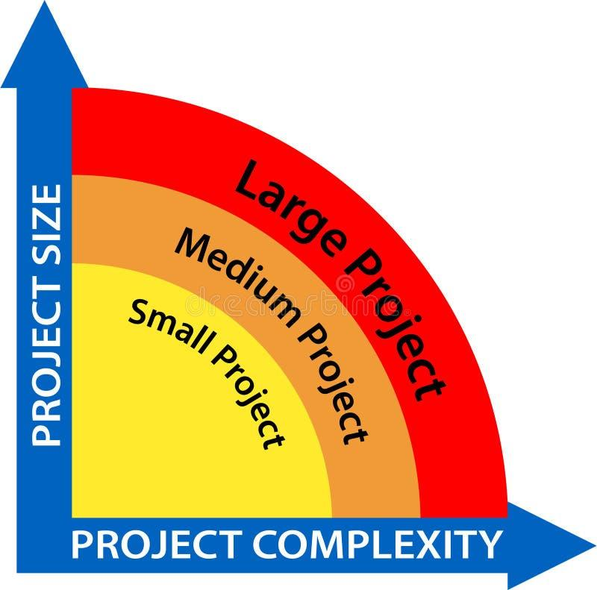
Factors Influencing the Quality of Estimates
Several factors can impact the accuracy of project estimates:
Planning Horizon: Estimates become less accurate as the project timeline extends.
Project Complexity: More complex projects are inherently harder to estimate.
People: Skill, experience, and bias of estimators affect accuracy.
Organization Culture: Cultural norms around estimation can introduce bias (e.g., padding).
Paddings and Risks: Unaccounted risks and deliberate padding inflate estimates.
External Factors: Market conditions, regulations, and economic factors.

Slide 4

Estimating Guidelines for Time, Cost, and Resources
To develop reliable estimates, follow these guidelines:
Define Work Clearly: Ensure a clear understanding of project scope and deliverables.
Use Consistent Methods: Apply standardized estimation techniques across the project.
Involve Experts: Consult with subject matter experts for specialized tasks.
Document Assumptions: Clearly state all assumptions underlying the estimates.
Refine Estimates Over Time: Update estimates as more information becomes available.
Use historical data: Leverage past project data as a benchmark to get a precise estimation.

Slide 5

Estimation Classification: Top-Down vs. Bottom-Up
Two primary approaches to project estimation exist:
Top-Down Estimating:
Uses overall project parameters to derive estimates for individual tasks.
Suitable for early project phases with limited detail.
Example: Estimating total project cost based on similar past projects.
Bottom-Up Estimating:
Estimates individual task costs and aggregates them to determine total project cost.
More accurate but requires detailed project planning.
Example: Estimating the cost of each work package in the WBS and summing them up.

Slide 6

Top-Down Estimating Approaches
Top-down methods are useful when detailed information is scarce:
Consensus: Expert opinions are combined to reach an agreement.
Ratio: Uses historical ratios to estimate current project costs.
Apportion: Allocates a percentage of the total budget to various project phases.
Function Point: Estimates software development effort based on system features.
Learning Curves: Accounts for efficiency gains as team members become more proficient.

Slide 7

Bottom-Up Estimating Approach
Bottom-up estimating involves detailed analysis at the work package level:
Process:
Decompose the project into work packages using a Work Breakdown Structure (WBS).
Estimate the time, cost, and resources required for each work package.
Aggregate the individual estimates to determine the total project estimate.
Accuracy: High accuracy due to detailed analysis.
Effort: More time-consuming and resource-intensive than top-down methods.

Slide 8
Comparing Top-Down vs Bottom-Up Approaches
Feature | Top-Down Estimating | Bottom-Up Estimating
Accuracy | Lower | Higher
Effort | Less | More
Phase | Early stages | Later stages
Input | High-level project data | Detailed WBS data
Output | Overall project estimate | Detailed task-level estimates
Notes:
| Feature | Top-Down Estimating | Bottom-Up Estimating |
| --- | --- | --- |
| Accuracy | Lower | Higher |
| Effort | Less | More |
| Phase | Early stages | Later stages |
| Input | High-level project data | Detailed WBS data |
| Output | Overall project estimate | Detailed task-level estimates |

Slide 9

Consensus Methods
Consensus methods rely on team expertise:
Description: A team of experts collaborates to arrive at an estimate based on their collective knowledge and experience.
Application: Useful when limited data is available or when project scope is not well-defined.
Process: The team discusses the project requirements and potential challenges, then collectively agrees on an estimate.
Benefit: Leverages diverse perspectives and promotes buy-in from team members.

Slide 10
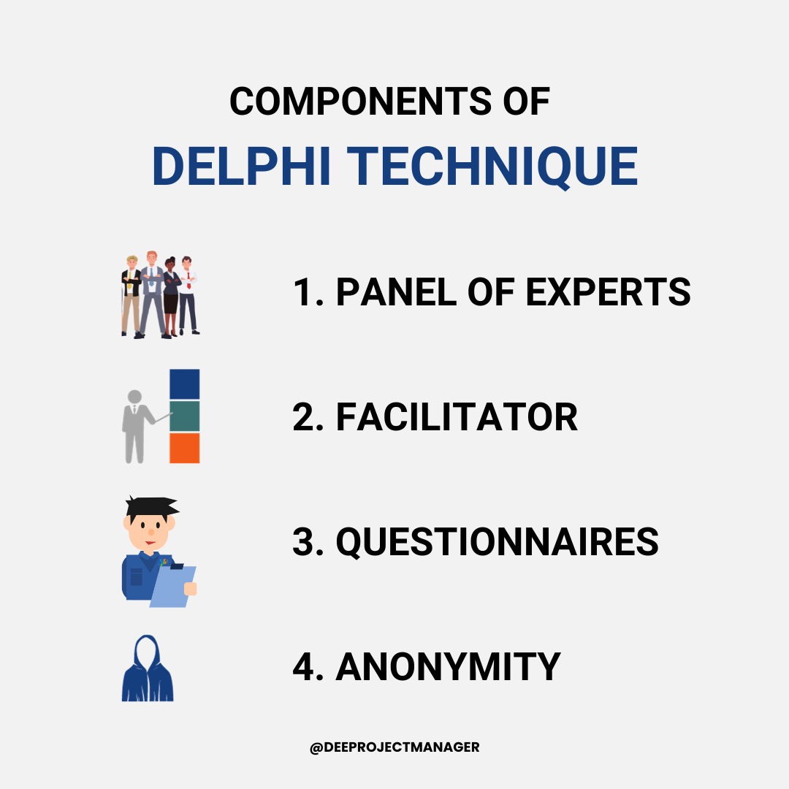
The Delphi Method (Part of Consensus Methods)
The Delphi method is a structured approach to consensus building:
Description: A panel of experts provides anonymous estimates, which are then shared and refined in multiple rounds.
Process:
Experts provide initial estimates anonymously.
Estimates are compiled and summarized.
Experts review the summary and revise their estimates.
Repeat steps 2 and 3 until estimates converge.
Benefits: Reduces bias and promotes objective decision-making.

Slide 11
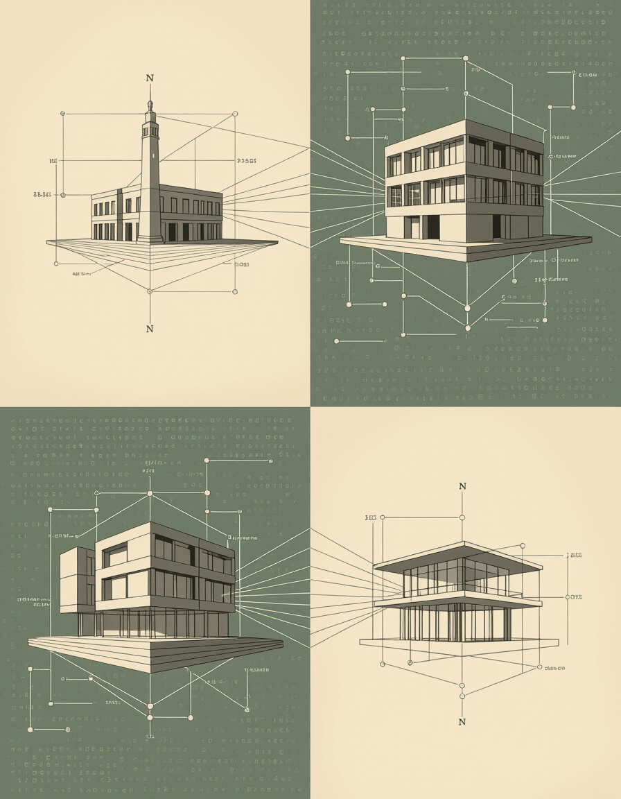
Ratio (Analogous) Methods
Ratio methods use historical data from similar projects:
Definition: Estimates are based on ratios or parameters derived from past projects.
Example: If a similar project cost $100,000 and took 6 months, the current project might be estimated using these figures as a benchmark.
Effectiveness: Most effective when projects are similar in scope, complexity, and resources.
Limitations: Accuracy depends on the quality and relevance of historical data.

Slide 12
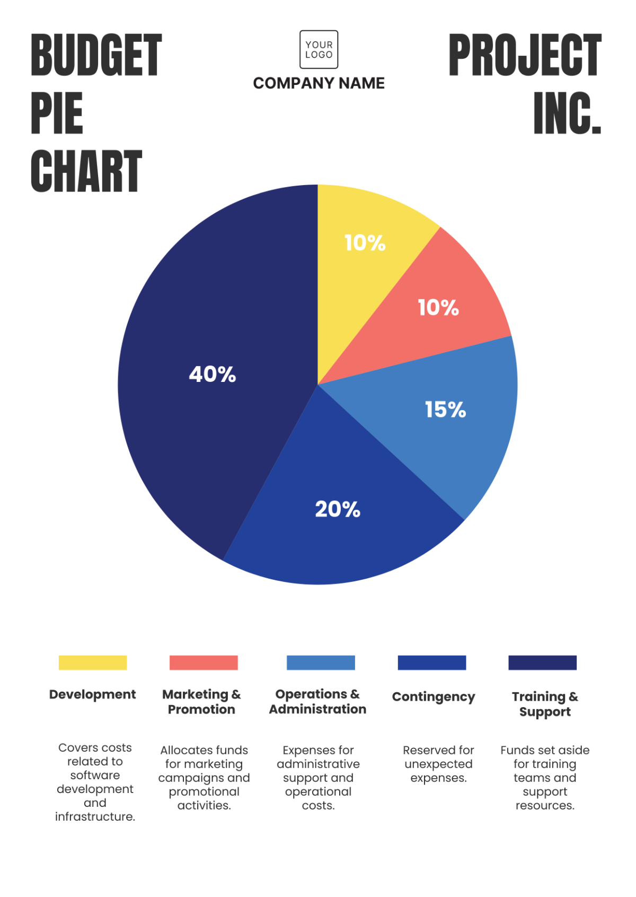
Apportion Method
The apportion method allocates costs based on historical percentages:
Description: The total project cost is divided among deliverables or phases based on predetermined percentages from previous projects.
Example:
Phase A: 20%
Phase B: 30%
Phase C: 50%
Application: Useful when historical data provides a reliable breakdown of cost distribution.

Slide 13
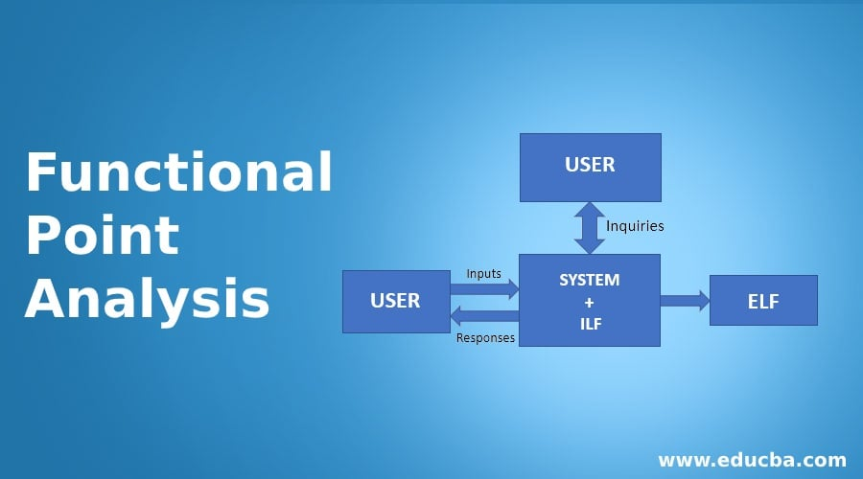
Function Point and Parametric Methods
Function Point Analysis and Parametric Estimating:
Function Point (FP) Method:
Estimates software development effort based on the functionality provided by the software.
Functionality is measured in terms of user inputs, outputs, inquiries, files, and interfaces.
Parametric Estimating:
Uses statistical relationships between project parameters and costs.
Examples: Cost per line of code (SLOC), cost per square foot of construction.

Slide 14
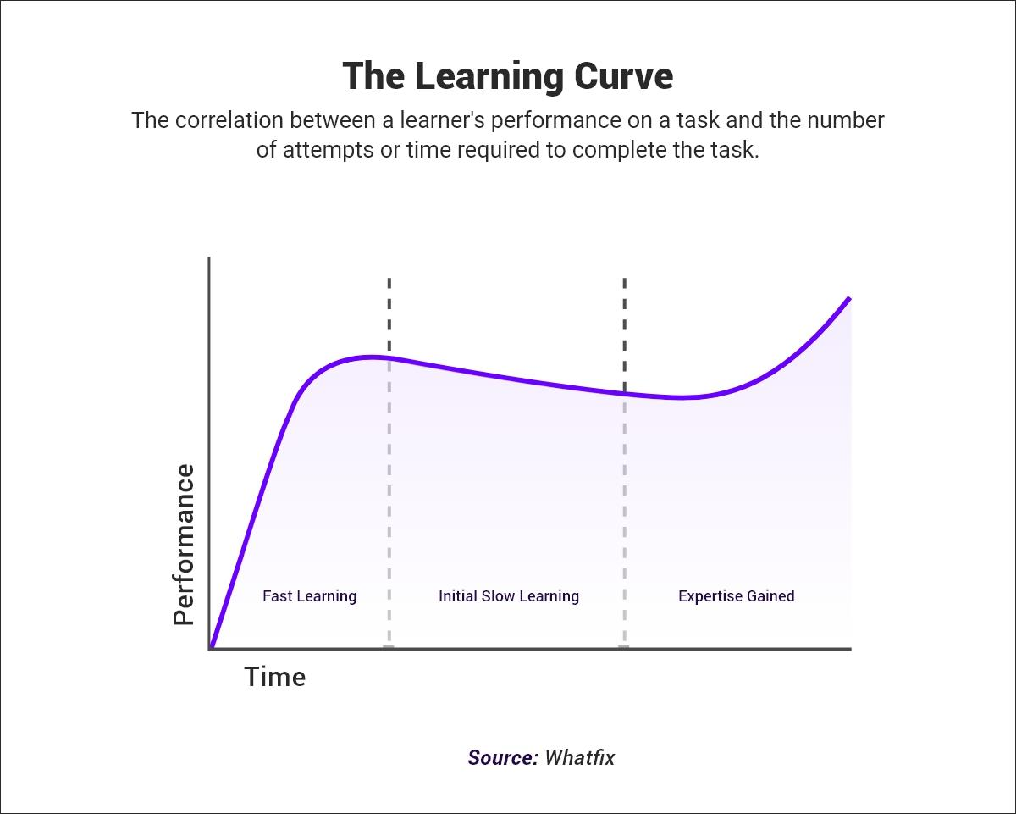
Learning Curves in Estimating
The learning curve effect accounts for improved efficiency:
Description: As tasks are repeated, efficiency increases due to learning and experience.
Formula: Y = aX^b
Y = time to complete the Xth unit
a = time to complete the first unit
X = number of units
b = learning curve exponent (log learning percentage/log 2)
Example: An 80% learning curve means that the time to complete the next unit is 80% of the time to complete the previous unit.

Slide 15
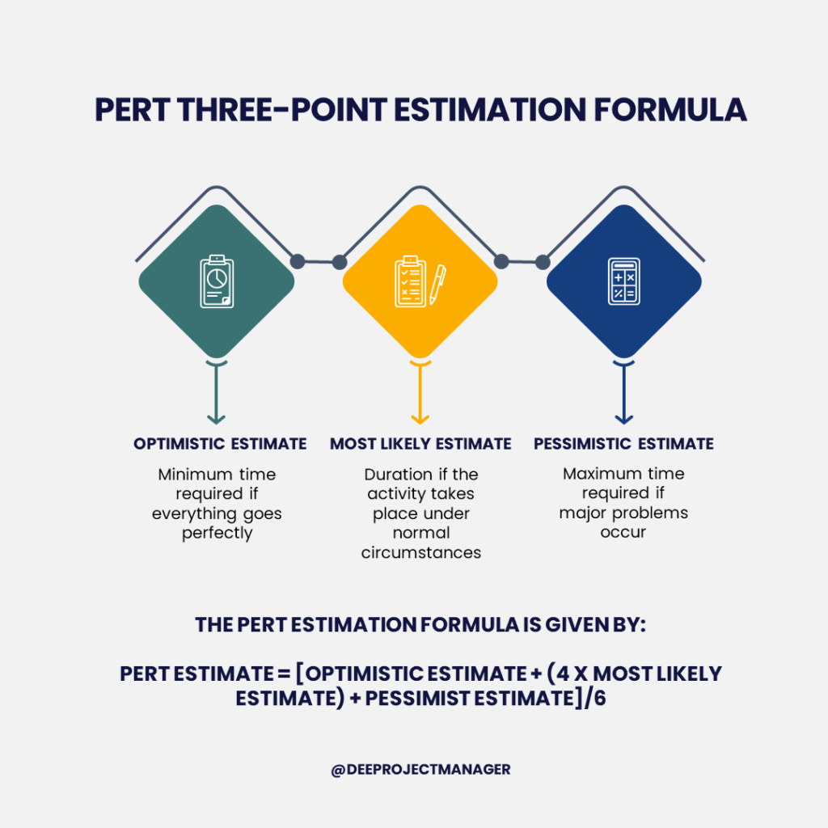
Range Estimating (Three-Point or PERT Method)
Range estimating manages uncertainty:
Description: Uses optimistic, pessimistic, and most likely estimates to determine the expected time or cost.
Formula: TE = (O + 4M + P)/6
TE = Expected Time
O = Optimistic Estimate
M = Most Likely Estimate
P = Pessimistic Estimate
Application: Helps account for uncertainty and variability in project estimates.

Slide 16

Template, Parametric, and Simulation-Based Estimation
Advanced estimation techniques:
Template-Based Estimation: Utilizes pre-defined templates from similar past projects.
Parametric Modeling: Employs statistical models to predict costs based on project parameters.
Simulation (Monte Carlo): Uses computer simulations to model project outcomes under various scenarios, accounting for uncertainty and risk.

Slide 17
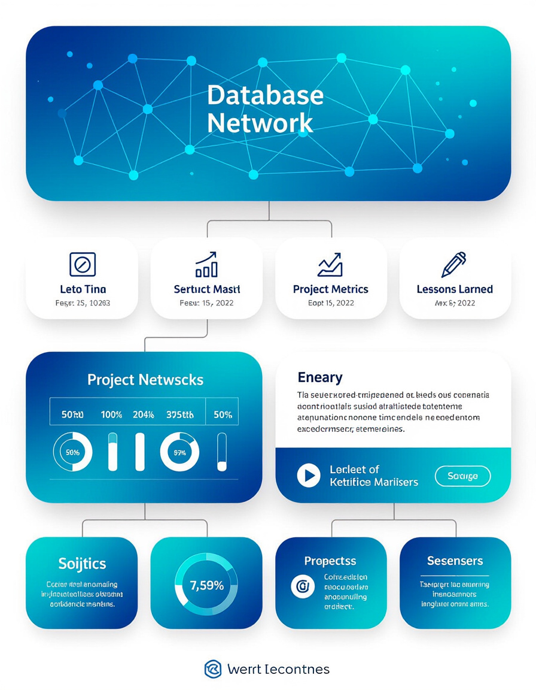
Developing the Project Time and Cost Database
Building a historical database for future improvements:
Importance: Collecting and maintaining historical data from past projects is crucial for improving future estimates.
Components:
Actual time and cost data
Project characteristics (size, complexity, technology)
Lessons learned
Estimation methods used
Benefits: Provides benchmarks for estimating, identifies trends, and improves accuracy.

Slide 18
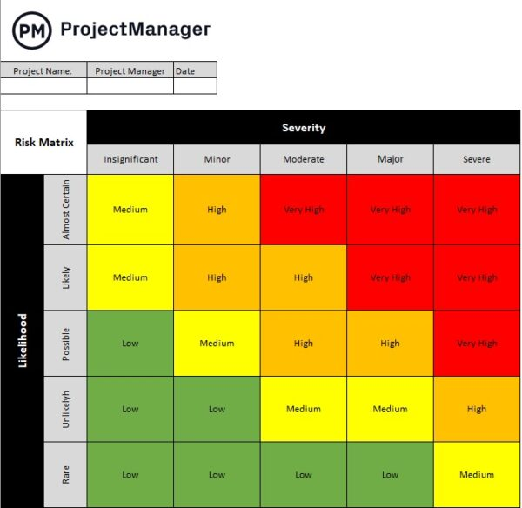
Adjusting Estimates: Contingency and Risk
Accounting for uncertainty:
Contingency Reserves: Added to estimates to cover known and unknown risks.
Known Risks: Identified risks with a defined probability and impact.
Unknown Risks: Unforeseen events that may impact the project.
Risk Management: Incorporate risk assessment and mitigation strategies into the estimating process.

Slide 19

Hybrid and Iterative Estimation Approaches
Combining top-down and bottom-up methods:
Hybrid Approach: Combines top-down and bottom-up techniques to leverage their respective strengths.
Iterative Estimation: Estimates are continuously refined throughout the project lifecycle as more information becomes available.
Agile and Rolling Wave Planning: Adaptive methodologies that use short iterations and frequent re-estimation.

Slide 20

Summary and Best Practices
Key takeaways and best practices:
Method Selection: Choose estimation methods based on project phase, data availability, and project complexity.
Balance Accuracy vs. Effort: Strive for the right level of accuracy without excessive effort.
Update Estimates: Continuously refine estimates as the project progresses and new information emerges.
Document Everything: Record all assumptions, methods, and data used in the estimating process.

Slide 21
References
Larson, E. W., & Gray, C. F. (2018). Project Management: The Managerial Process (8th ed.). McGraw-Hill Education.
Project Management Institute. (2017). A Guide to the Project Management Body of Knowledge (PMBOK® Guide) (6th ed.). Project Management Institute.

